Slide 1
The effect of mental health on the academic performance of students
PRE ANALYSIS DONE BY ALLI TAIWO TOSIN
MATRIC NO : 20172790
DEPARTMENT: STATISTICS

Slide 2
INTRODUCTION
Mental health is so important that it controls the energy we give to our daily activities, and coping with stress level. Our effectiveness is controlled by our mental health. Some mental health issues can be as a result of stress level which might reduce functionality and brain activeness. Some might just take enough sleep to get back to a good mental state, but when a person’s mental health continuously has effect in his or daily life activities like work, social life, and education, this can be manged
Mental health is a state of wellbeing in which individual realizes his or her own abilities , can cope with the normal stresses of life, can work productively and fruitfully and is able to make contribution to his or her community.

Slide 3
DATA DISCRIPTION
This project data is collated by performing some research on FUNAAB student which is.
Survey the students
Evaluation of the surveys
Comparing analysis
Data gathering
Present the facts, draw conclusions and summarize

Slide 4
AIMS AND OBJECTIVES
The general objective of this study is to determine the effect of mental health on the academic performance of students in FUNAAB
Examine the individual challenges of students in FUNAAB which has to do with one of the factors of mental health
Examine the academic performance and challenges student face in their academics
Establish the relationship between their mental health and their academic performance

Slide 5
AIMS AND OBJECTIVES
The aim of this analysis is to bring awareness to the institution, that is, the impact of a poor mental health on students and how this has affected their academic performance.
This will also help institutions manage and run an efficient health education system to help student reduce their stress level and manage the educational activities with their individual challenges.
Student can also learn to manage their mental health, cope with pressuring activities and their and perform better academically.

Slide 6
Literature review
Today’s younger generation represents the largest group of students in history’ the transition from adolescence into young adulthood involves majo changes in several areas-financial, housing, social and emotional and this transition period can cause relational challenges that some young adult experience as stressful. It has also been maintained that the proportion of students who experience their student life as mentally stressful is increasing (Nedregard and Olsen 2014). This trend may suggest student experience this period increasingly demanding and for some of them, it may be direct cause of mental illness (Nerdrum et al., 2009).

Slide 7
METHODOLOGY
Data collected were analyzed using inferential statistics of regression analysis and correlation analysis .R programming language was used for the analysis of the data
What is Regression Analysis?
Regression analysis allows you to examine the relationship between two or more variables of interest. While there are many types of regression analysis, they all examine the influence of one or more independent variables on a dependent variable
Regression analysis produces a regression equation where the coefficient represents the relationship between each independent variable and the dependent variable

Slide 8
METHODOLOGY
Correlation which was carried out in this analysis will help to show the degree of relationship between the variables considered.
Correlation analysis in research is a statistical method used to measure the strength of the linear relationship between two variables and compute their association. Simply put - correlation analysis calculates the level of change in one variable due to the change in the other.
A high correlation points to a strong relationship between the two variables, while a low correlation means that the variables are weakly related.

Slide 9
METHODOLOGY
REGRESSION ANALYSIS
LINEAR
REGRESSION
NON LINEAR REGRESSIOM
MULTIPLE LINEAR
REGRESION

Slide 10
Data description and analysis
1 DATA PRESENTATION:
The data collected was with a population size of about 1500 students of which 300 samples was generated

Slide 11
Data description and analysis

Slide 12
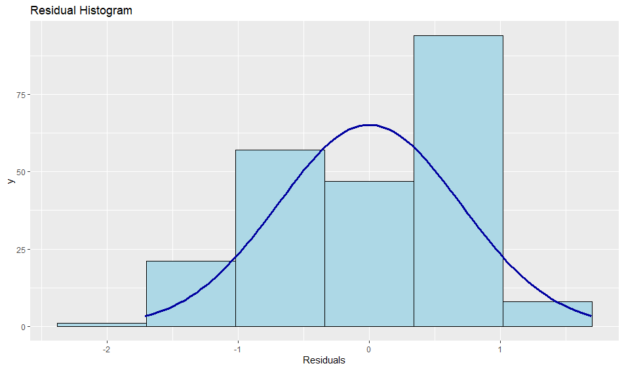
Data description and analysis
The analysis was carried out using R programming language.
OUTPUT AND INTERPRETATION
Assumptions of multiple regression
Normality of the Residuals
Interpretation: The residual histogram plot shows that the residuals are normally distributed

Slide 13
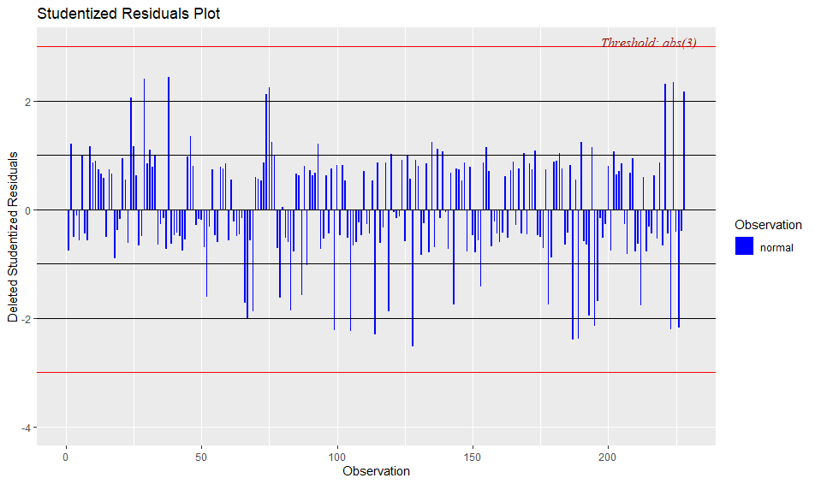
Data description and analysis
Outlier Diagnostics:
Interpretation:The plot above shows no outlier in the data

Slide 14
Data description and analysis
Regression Analysis
Regression ModelCall:lm(formula = Aperf ~ Estab + Rel + Finances + Achal + SEHa, data = data)
Coefficients:
(Intercept) Estab Rel Finances Achal SEHa
2.75819 -0.1098 0.0986 0.07614 0.09980 0.09418
Interpretation:
The multiple regression model is
given as: Y = β₀ + β₁X₁ + β₂X₂ + β₃X₃ + β₄X₄ + β₅X₅
From the analysis above the following model is derived;Y = 2.75819 + -0.10985X₁ + 0.09868X₂ + 0.07614X₃ + 0.09980X₄ + 0.09418X₅
Where:
X₁ represents emotional stability
X₂ represents relationship
X₃ represents financial stability
X₄ represents academic challenges
X₅ represents sleeping and eating habit

Slide 15
Data description and analysis
Correlation Analysis
Estab -0.13300978 1.00000000 -0.38414916 0.01551069 -0.01731066 -0.26027509
Rel 0.16147440 -0.38414916 1.00000000 -0.05623226 0.04731068 0.12957184
Achal 0.06390663 0.01551069 -0.05623226 1.00000000 0.11563022 0.05844359
Finances 0.07406743 -0.01731066 0.04731068 0.11563022 1.00000000 -0.11665794
SEHa 0.10621927 -0.26027509 0.12957184 0.05844359 -0.11665794 1.00000000
Interpretation:
There is a low negative correlation between academic performance and emotional stability.
There is a low positive correlation between academic performance and relationship health.
There is a low positive correlation between academic performance and academic challenges.
There is a low positive correlation between academic performance and finances.
There is a low positive correlation between academic performance and sleeping and eating habit.

Slide 16
CONCLUSION AND RECOMMENDATIONS
Based on the findings, it could be concluded that the mental health of students in FUNAAB has an effect on their academic performance. Emotional instability has a strong negative effect on the academic performance of students.
RECOMMENDATIONS
The results emphasize the necessity to detect external and internal factors at early stages and continuously throughout the school years. In practice, it means that these kinds of problems need to be noticed in universities and educational practices adjusted and adequate treatment given to promote transition to the school environment and completion of compulsory school.
University managements should help by organizing seminars to aid students in controlling their mental health and provide better learning environment. University students should also learn to manage their academics with other activities so as to be able to balance studying and other life activities.

Slide 17
REFERENCES
Halpern-Manners A, Schnabel L, Hernandez EM, Silberg JL, Eaves LJ (2016) The relationship between education and mental health: new evidence from a discordant twin study. Soc Forces 95(1):107–131
Ritsher JE, Warner V, Johnson JG, Dohrenwend BP (2001) Inter- generational longitudinal study of social class and depression: a test of social causation and social selection models. Br J Psychia- try Suppl 40:84–90
Esch P, Bocquet V, Pull C, Couffignal S, Lehnert T, Graas M, Fond-Harmant L, Ansseau M (2014) The downward spiral of mental disorders and educational attainment: a systematic review on early school leaving. BMC Psychiatry 27(14):237
Fletcher JM (2010) Adolescent depression and educational attain- ment: results using sibling fixed effects. Health Econ 19:855–871
agnuson K, Duncan G, Lee KTH, Metzger M (2016) Early school adjustment and educational attainment. Am Educ Res J 53(4):1198–1228
Caspi A, Moffitt TE, Newman DL, Silva PA (1996) Behavioral observations at age 3 years predict adult psychiatric disorders. Longitudinal evidence from a birth cohort. Arch Gen Psychiatry 53:1033–1039
Miech RA, Caspi A, Moffitt TE, Wright BE, Silva PA (1999) Low socioeconomic status and mental disorders: a longitudinal study of selection and causation during young adulthood. Center for Demography and Ecology University of Wisconsin, Wisconsin

